Slide 1


PIZZA SALES ANALYSIS
By Anurag Sharma

Slide 2
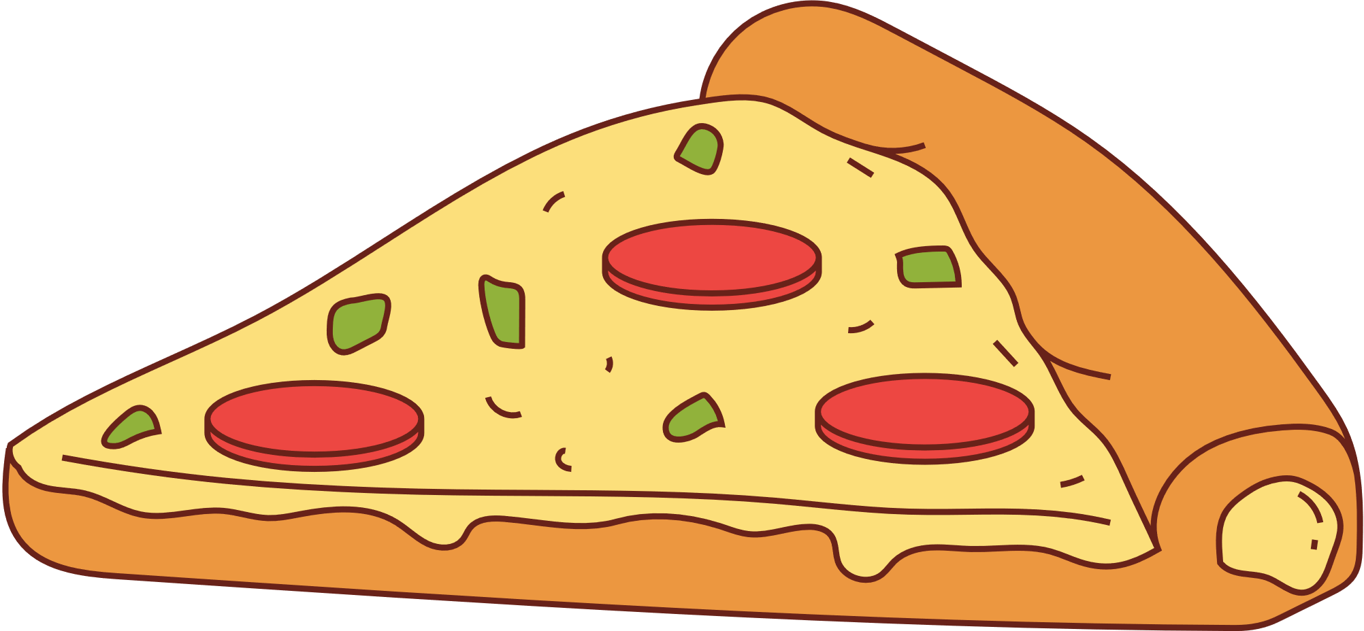
Problem to solve
Determine KPIs for orders and sales revenue for year 2015.
Find out best selling item, category based on quantity and revenue.
Analyze the cumulative revenue generated over time.
Provide insights to run an ad campaign to improve thier sales.

Slide 3
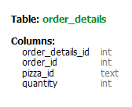
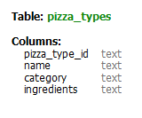
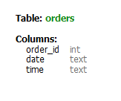
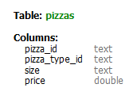
Table Details

Slide 4
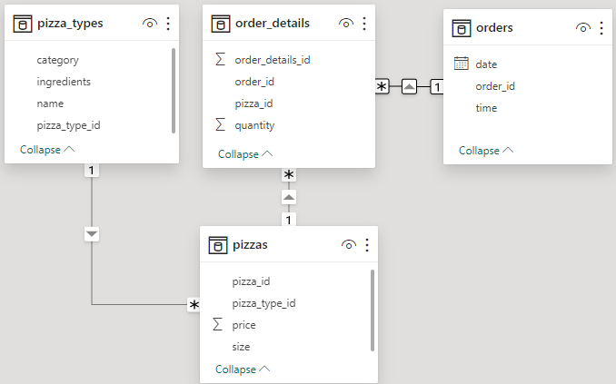
Schema

Slide 5
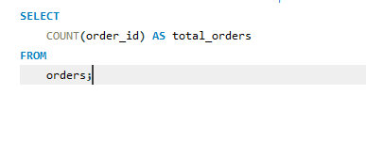

Retrieve the total number of orders placed
Total orders: 21350

Slide 6
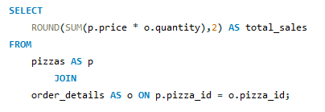
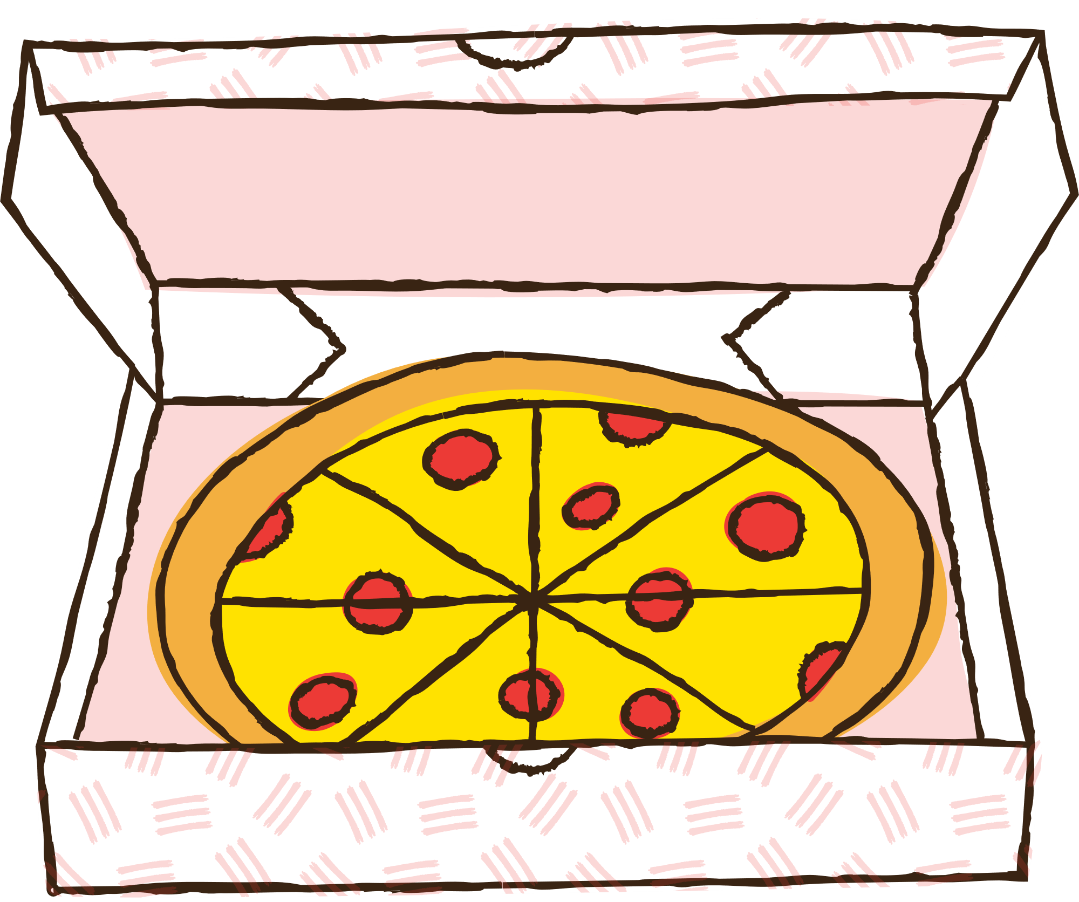

Calculate the total revenue generated from pizza sales
Total Revenue: 817860.05

Slide 7
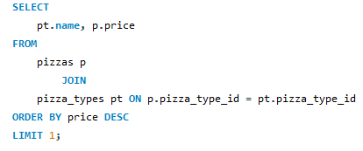
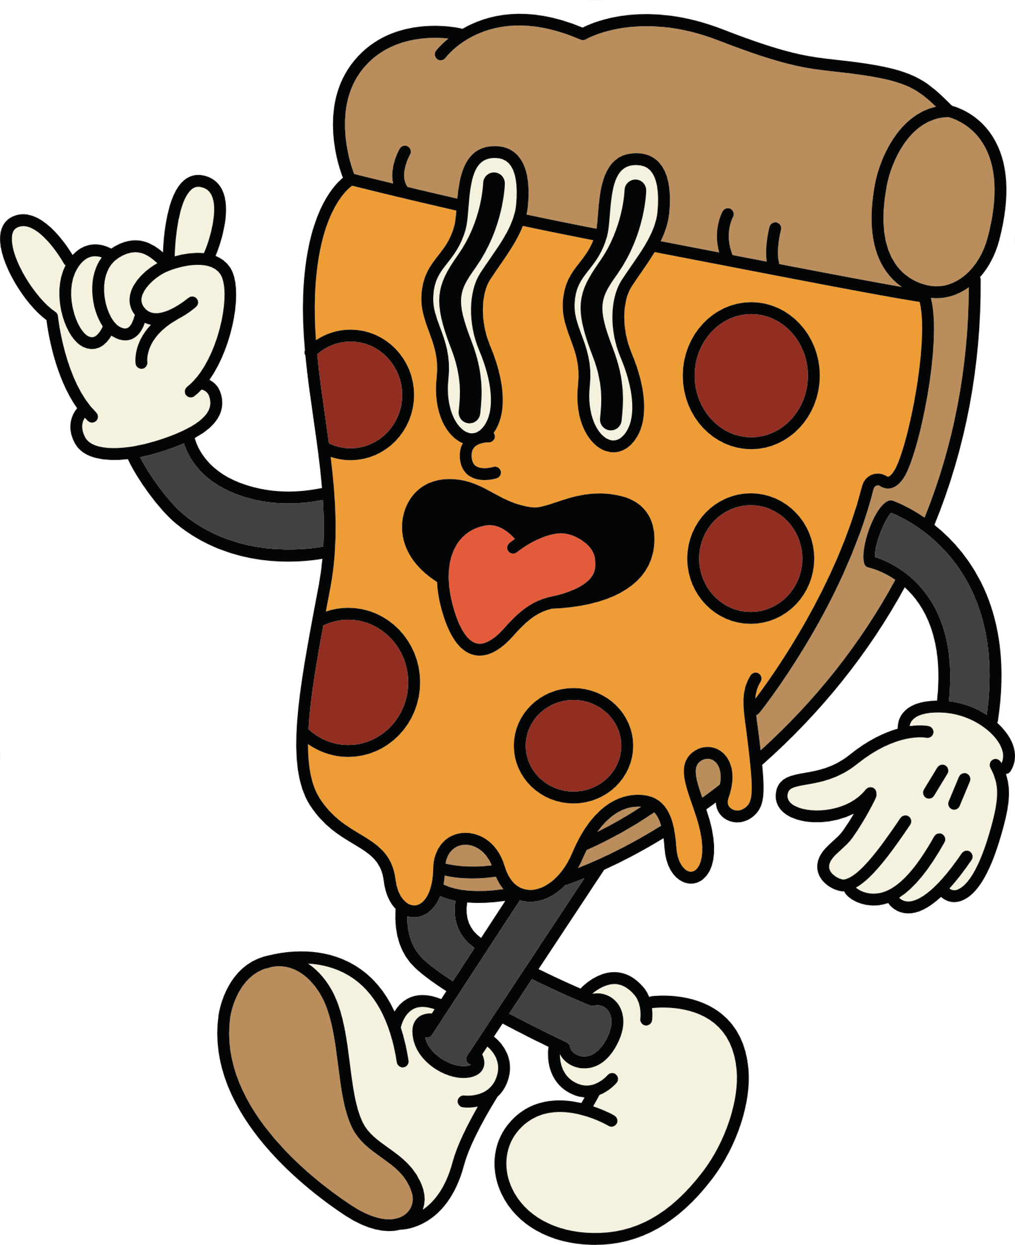

Identify the highest-priced pizza
Highest Priced Pizza: The Greek Pizza

Slide 8

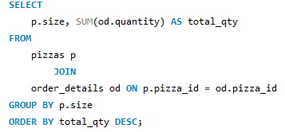
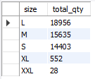
Identify the most common pizza size ordered
Most Common Size Ordered: Large

Slide 9
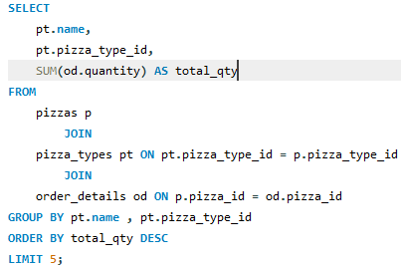
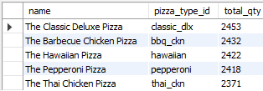
List the top 5 most ordered pizza types along with their quantities
Top Pizza Ordered: The Classic Delux Pizza; 2453

Slide 10
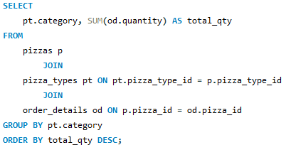

Find the total quantity of each pizza category ordered
Highest Category Sold: Classic; 14888

Slide 11
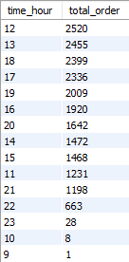
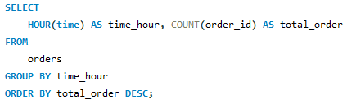
Determine the distribution of orders by hour of the day
Highest Selling Hour: 12pm

Slide 12
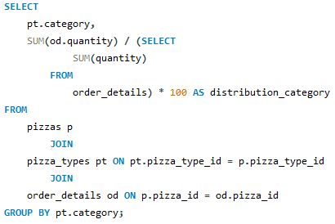

Find the category-wise distribution of pizzas
Highest distribution: Classic; 30%

Slide 13
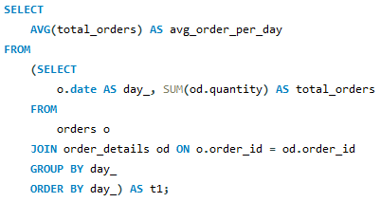

Calculate the average number of pizzas ordered per day
Average Order per Day: 138.48

Slide 14
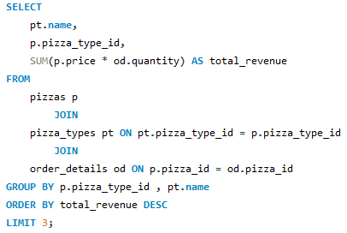

Determine the top 3 most ordered pizza type based on revenue
Highest Revenue Pizza: The Thai Chicken Pizza; 43434

Slide 15
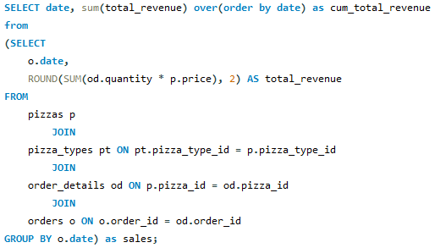
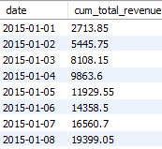
Analyze the cumulative revenue generated over time

Slide 16
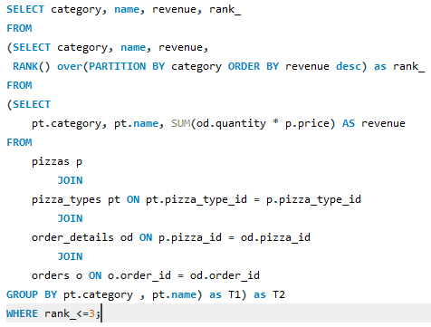
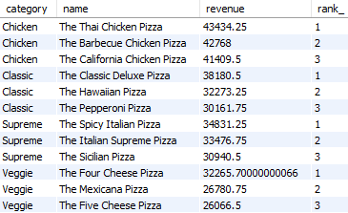
Determine the top 3 most ordered pizza types based on revenue for each pizza category

Slide 17
Conclusion
Use social media ads to highlight your top-selling items and deals, focusing on large Classic Deluxe Pizzas. Engage customers with posts that include customer reviews, mouth-watering photos, and limited-time offers specifically aimed at afternoon buyers.

